Slide 1
PROJECT
SPACE TRAVEL DASHBOARD
DESCRIPTION :
The Space Travel Dashboard project harnesses the power of Excel to create an interactive and visually engaging dashboard that tracks and analyzes various aspects of space travel. This project aims to provide comprehensive insights into space missions, spacecraft performance, astronaut activities, and related financial data, making it a valuable tool for enthusiasts, researchers, and industry professionals.

Slide 2
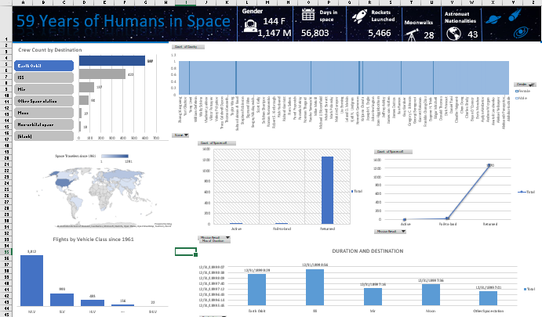
Overview :

Slide 3
Insights1: Crew count by destination

Slide 4
Insight 2: Males and Females from countries

Slide 5
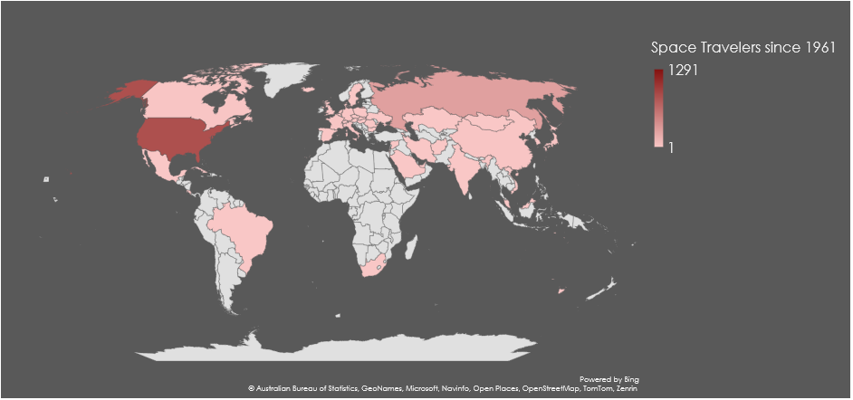
Insight 3 : Travel areas

Slide 6
Insight 4:Mission Result

Slide 7
Insight 5:Duration and destination

Slide 8
THANK YOU

